Slide 1

ELO2:
Climate Predictions in Sudan
Exploring temperature and rainfall trends to support
climate understanding using data science

Slide 2
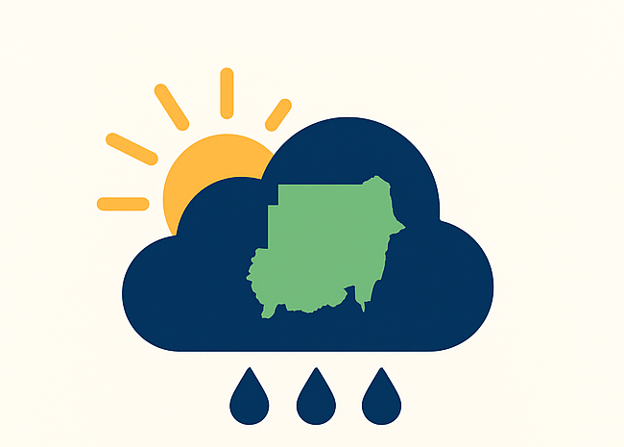






Contents
Introduction:
Weather changes shape how communities live, grow and plan for the future. Many regions still struggle with irregular rainfall and rising temperatures, which affect farming, water security and daily life.

Slide 3
Contents
Purposes & Research Questions:
In Sudan, these shifts often go unmeasured, so the patterns behind them remain unclear.
How have temperature and rainfall patterns in Sudan changed from 1990 to 2024, and how accurately can machine learning models predict future trends?

Slide 4
Contents
Data Process:
This project uses the NASA POWER database to collect climate data for Sudan, focusing on 2-meter air temperature (°C) and total corrected precipitation (mm/day).
Sudan is divided into five regions for analysis. Data for each region are collected, cleaned, and merged into structured datasets suitable for machine learning modeling.

Slide 5
Contents
Model Findings:
Rainfall is more irregular, so predictions vary between regions and some months are harder to forecast accurately.
Temperature follows a steady seasonal pattern, making predictions relatively reliable.
Forecasts are intended as guidance to understand trends, rather than exact predictions for operational planning.

Slide 6
Contents
Regional Insights:
Temperature trends: Temperatures are slightly increasing in recent years.
Rainfall variability: Southern and Western regions show more fluctuation, while the North remains mostly dry and stable.
Inverse relationships: Most regions (Central, East, South, West) show negative correlations between rainfall and temperature.
Northern region anomaly: Slight positive correlation due to very low rainfall.

Slide 7
Contents
Reflection:
This project analyzes these patterns using clean data and scientific methods. It traces how rainfall and temperature change over time and produces predictions that support better planning and deeper understanding.
Icons from (icon lord)

Slide 8
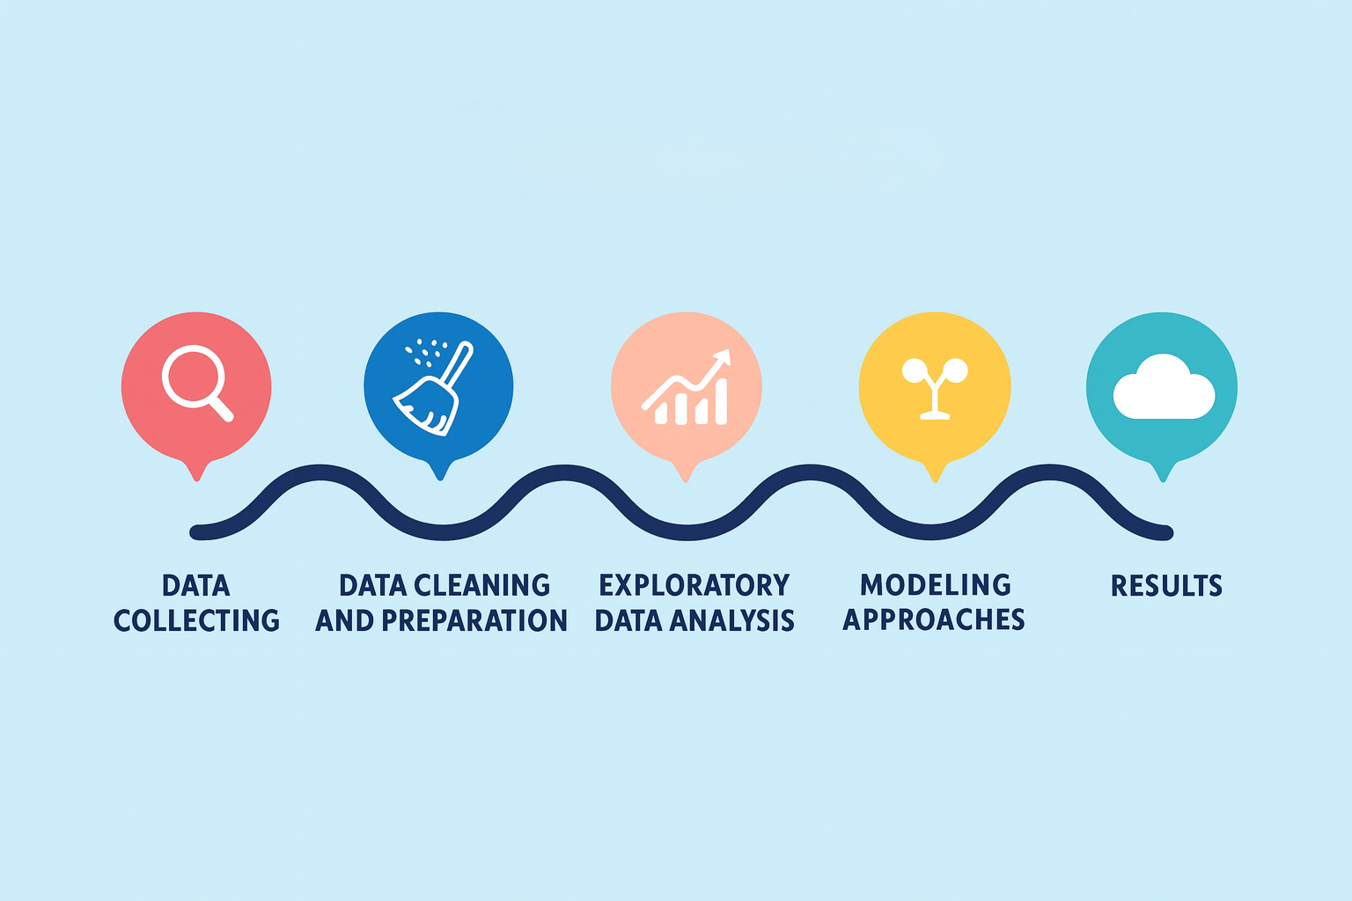
Project Workflow
Data Collecting Gather climate variables from trusted sources to build a complete and consistent dataset.

Slide 9
Project Workflow
Data Cleaning and Preparation Fix missing values, remove errors and convert the data into formats suitable for analysis.
Data Collecting Gather climate variables from trusted sources to build a complete and consistent dataset.

Slide 10
Project Workflow
Exploratory Data Analysis Study patterns, trends and relationships in rainfall and temperature to understand how they behave over time.

Slide 11
Project Workflow
Modeling Approaches Test different models to capture climate dynamics and generate predictions.
Exploratory Data Analysis Study patterns, trends and relationships in rainfall and temperature to understand how they behave over time.

Slide 12
Project Workflow
Results Present key insights, visualizations and forecasts that support planning and understanding.

Slide 13

Future Work and Improvements
This project is only the first step toward building a reliable climate insight tool. While the current version provides structured data, clear trends and early predictive models, there are several areas that can be improved.

Slide 14
Current Limitations
These issues guide what needs improvement and help shape the next phase of the project.

Slide 15
Current Limitations
These issues guide what needs improvement and help shape the next phase of the project.
Only rainfall and temperature are included, which limits the ability to capture full climate relationships.

Slide 16
Current Limitations
These issues guide what needs improvement and help shape the next phase of the project.
Only rainfall and temperature are included, which limits the ability to capture full climate relationships.
Predictions become less accurate during months with high variation, especially with rainfall values

Slide 17
Current Limitations
These issues guide what needs improvement and help shape the next phase of the project.
Only rainfall and temperature are included, which limits the ability to capture full climate relationships.
Predictions become less accurate during months with high variation, especially with rainfall values
The dataset does not cover local administrative boundaries, which reduces its direct usefulness for decision making.

Slide 18
Goals for Future Development
4
3
2
1

Slide 19
Goals for Future Development
Expand the dataset: Include more climate variables, such as humidity, wind speed and soil moisture. This will give a broader view of environmental conditions.
4
3
2
1

Slide 20
Goals for Future Development
Increase geographical detail: Collect data at the city or village level instead of coordinate-based points. This makes results easier to interpret for real communities.
4
3
2
1

Slide 21
Goals for Future Development
Add interactive features: Integrate map based visualizations, real time updates and a simple user interface so anyone can explore climate trends directly.
4
3
2
1

Slide 22
Goals for Future Development
Improve the prediction models: Test more advanced machine learning methods and tune the existing models to reduce error and improve long term reliability.
4
3
2
1

Slide 23





If you are interested in this work, have suggestions or want to collaborate, feel free to reach out. I am always open to new ideas that can support stronger and more reliable climate insights for communities.
GitHub
LinkedIn
Email: mohamed.tilal52@gmail.com
Developed individually by Mohamed Tilal as part of the MIT Emerging Talent program (ELO2).
Project Website

